Slide 1
Topic: Scale Drawings
EQ: How to produce scale drawings to build and decorate?

Slide 2
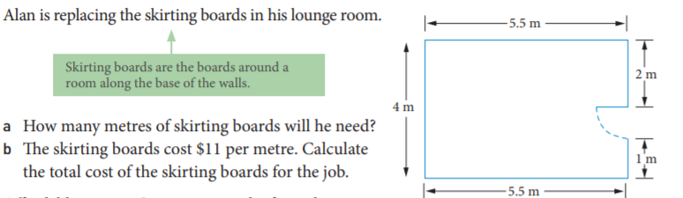
24
7
30
Scale Drawings
Date
EQ: How to produce scale drawings to use to build and decorate?
Example:

Slide 3
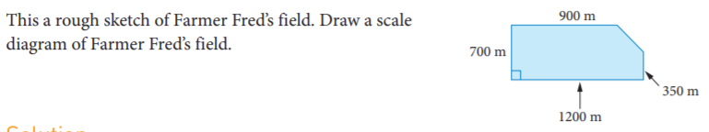
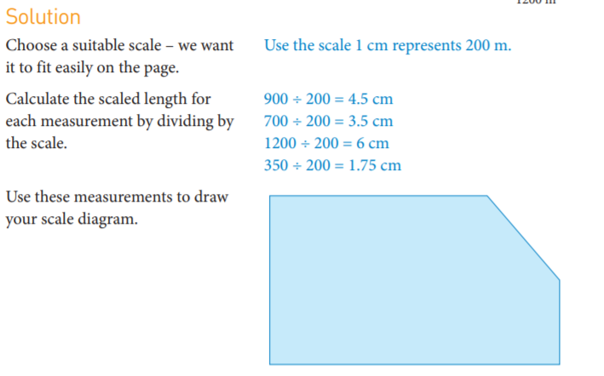
24
7
30
Scale Drawings
Date
EQ: How to produce scale drawings to use to build and decorate?
Example:

Slide 4
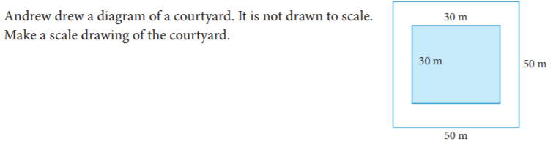
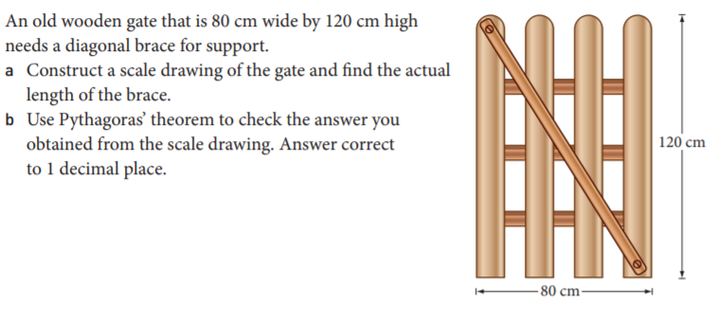
24
7
30
Scale Drawings
Date
EQ: How to produce scale drawings to use to build and decorate?
Try these:
Notes:
b) 144.2cm

Slide 5
24
7
30
Scale Drawings
Date
EQ: How to produce scale drawings to use to build and decorate?
You now need to prepare a couple of things:
EST tick list for your notes page for the EST assessment
Work through the Weekly Mathematical Thinking task for Practical Application 2
Notes:
b) 144.2cm

